Slide 1
Deep Learning CNN Cat/Dog Classifier w/ VGG16
CMPE-258 Deep Learning: Wil Carrasco

Slide 2
Outline
Introduction
Dataset
Evaluation and Implementation
Model
Results
Conclusion

Slide 3
Introduction
Convolutional Neural Network Classifier using VGG16
VGG16 is a CNN
Excellent vision model architecture
Won the LISVR (ImageNet) Competition
Using this model to classify random images of cats & dogs
Objective
Can we apply a convolutional neural network using VGG16 to correctly classify images of dogs and cats with a high degree of certainty as opposed to other methods?

Slide 4
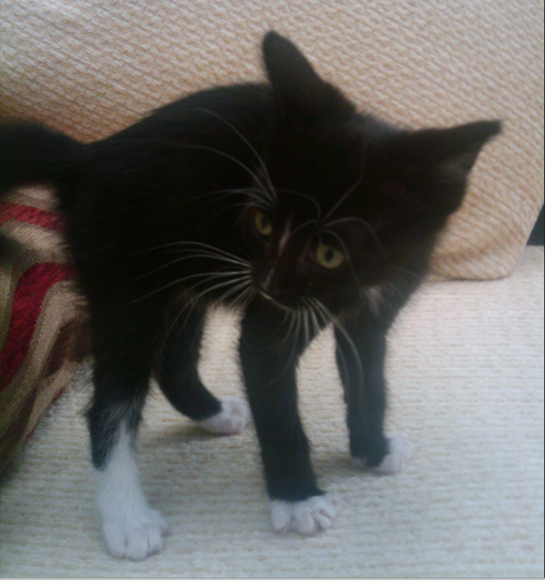
Dataset
Dogs and Cats dataset used in Kaggle competitions
Train set included 25000 images of dogs and cats (12.5k per animal type)
Additional test set with no labels included which was used to test the model (12.5k images in total)
Split the train dataset into a 90/10 split to be used to train/validate the model
Introduced random images to test against the model
Images where resized to 150 x150 prior to training/predictions
No other regularizations applied to the image

Slide 5
Implementation and Evaluation
Decided to create a classifier with two outputs on the final layer instead of a binary classifier
Used a Softmax activation to predict the probably of each class type
Two model implementations: A simple 3 layer CNN w/ a single hidden neural network and a classic VGG16 CNN model
Selected the highest predicted value and used the array index as the label: 0 – Cat | 1 – Dog
Training for the complex VGG16 model took 12+ hrs!
Simple model produced a ~87% accuracy score while the VGG16 produced a 91% accuracy score on the validation set

Slide 6
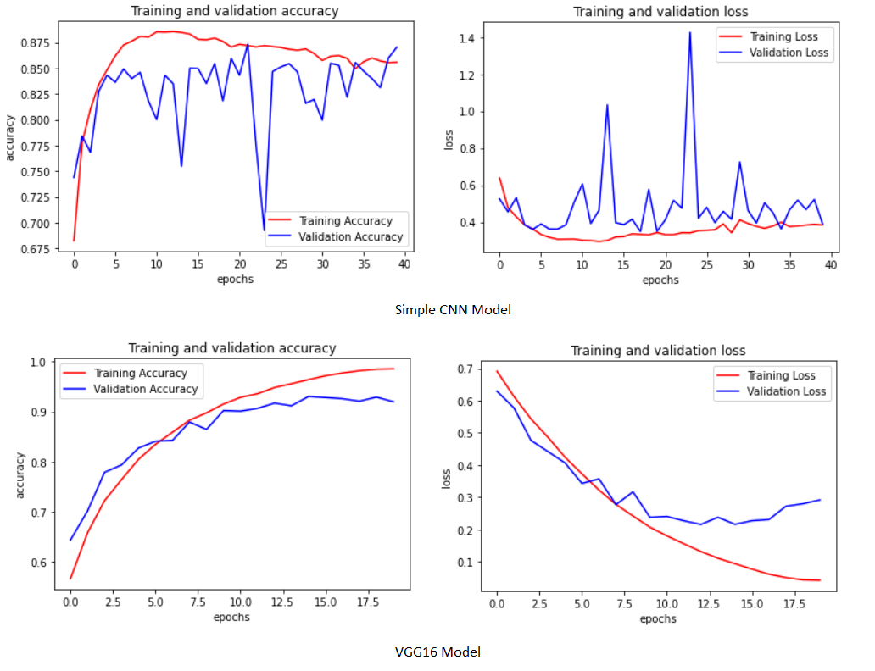
Evaluation and Implementation

Slide 7
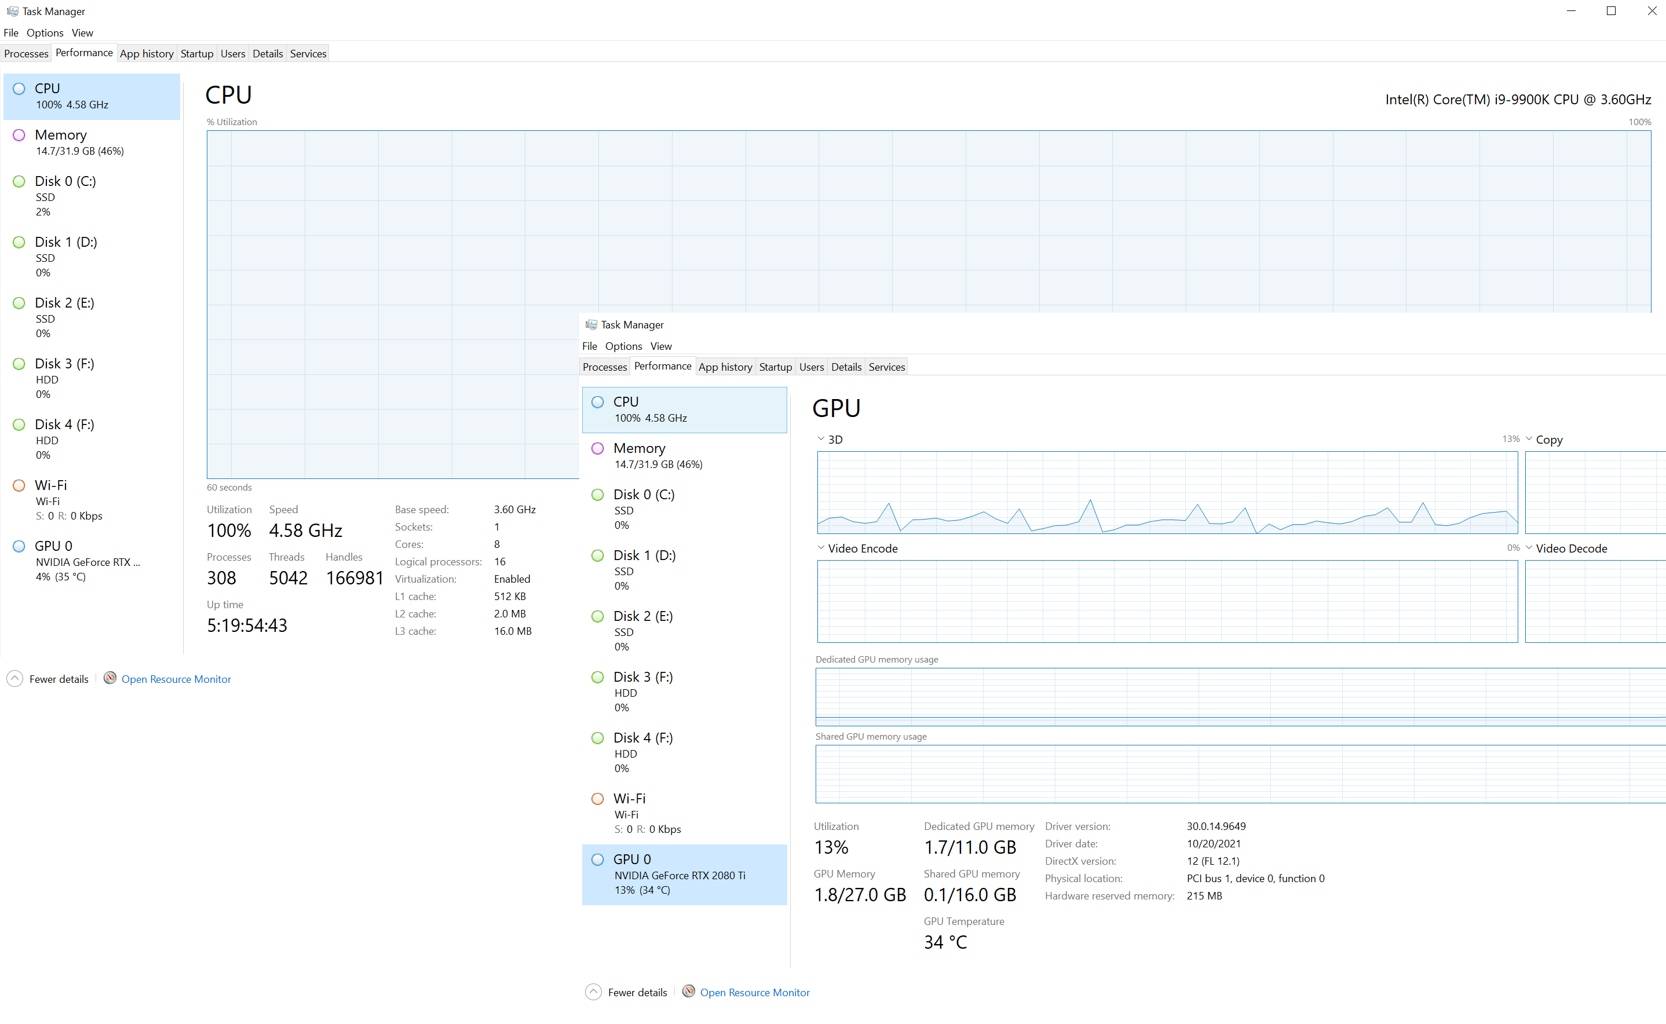
CPU / GPU Resources

Slide 8
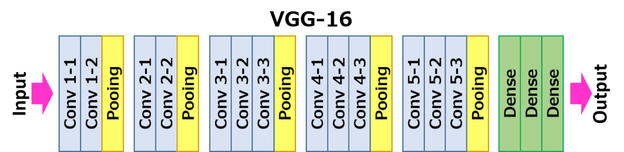
Model
VGG16 is a convolutional neural network model proposed by K. Simonyan and A. Zisser from the Universiry of Oxford
16 is the number of layers that have weights
Instead of a large set of hyperparameters, focus on multiple convolutional networks with 3 x 3 filters and stride of 1
My implementation had over 19 million trainable parameters!

Slide 9
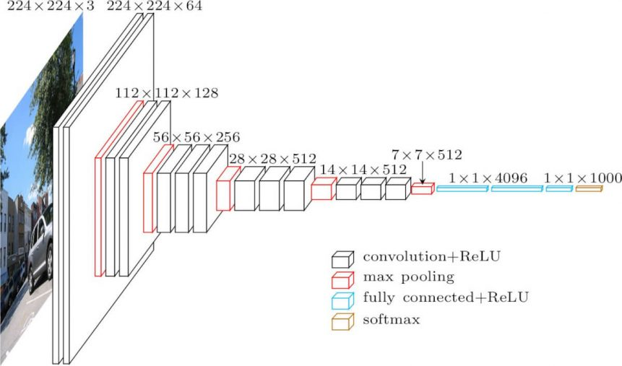
VGG16 Model

Slide 10
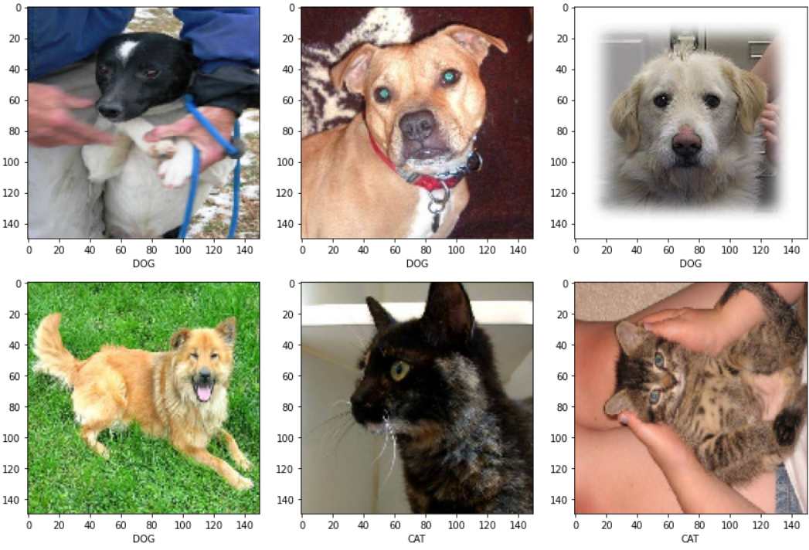
Results

Slide 11
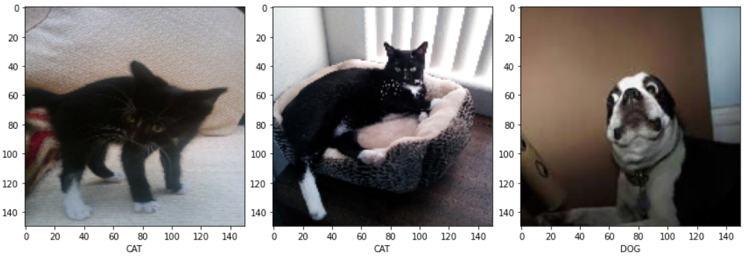
Results

Slide 12
Conclusion
Hyperparameter tunning is extremely important!
Time required to train the model
Saving model for future use
Lots of parameters to tune, Adam was not a good choice, stuck with Stochastic Gradient descent
Weight initializers important
Complex model better suited for multiple class types
Training and storage resources required for Deep Learning are large

Slide 13
Questions?

Slide 14
Github
https://github.com/wilcarrasco/CPME-258-Project

Slide 15
References
https://arxiv.org/pdf/1409.156.pdf
https://neurohive.io/en/popular-networks/vgg16
https://medium.com/@mygreatlearning/what-is-vgg16-introduction-to-vgg16-f2d63849f615
https://www.kaggle.com/c/dogs-vs-cats/data
https://neurohive.io/en/popular-networks/vgg16/
GitHub Repo: https://github.com/wilcarrasco/CPME-258-Project

